Slide 1
Business Skills Course for upcoming freelancers
Coderstrust
Airidas Brikas Edvards Banka
Corinne Cotteverte Tobias Navntoft
Petyo Zhechev

Slide 2
01. Our Solution
03. Business Skills Course
02. Quiz
04. Expectations for the future
Project Management-Financial Forecasting-Negotiation
Explanation & Quiz tutorial video

Slide 3
Our solution...
Our solution will equip new students at Coderstrust with necessary skills to become successful in the emerging gig-economy. The Business skills course curriculum contains material adapted towards new upcoming freelancers with little to no knowledge on how to start their career.
In order to steer traffic towards these courses we have designed a quiz to help new users find courses that will fulfill their needs and expectations.

Slide 4
2.1. Multiple Choice Quiz
Video Categories
GOALS
01
Social Media
Guest offered a quiz to figure out a starting point
Question?
multiple
02
Marketing
No right or wrong answers. Each gives points to different category
choice
answers
03
Programming
Guest suggested video based on test results

Slide 5

Quiz Example

Slide 6
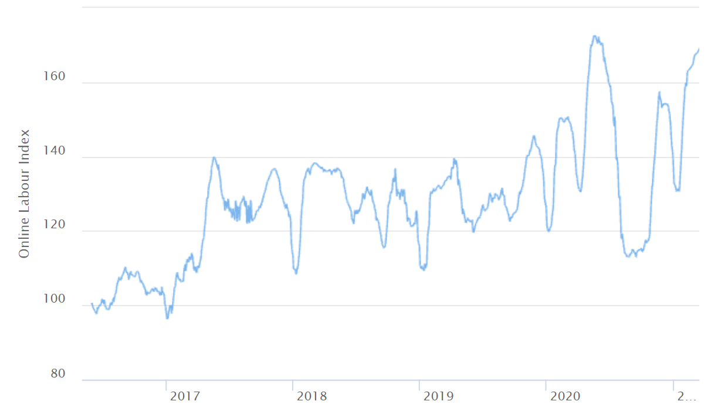
Almost all time high
60% growth in 5 years
The gig economy has grown by more than 60 percent over the past four to five years, almost hitting an alltime high as of 7th March 2021
Source: (The Online Labour Index, nd)

Slide 7
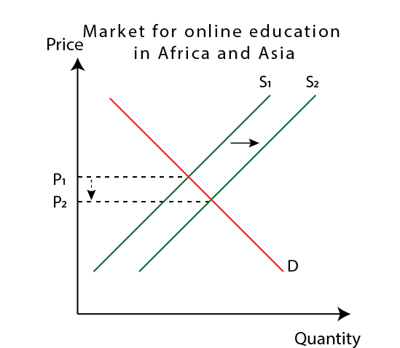
Growing MOOC market
The online education market is growing fast, and it is forecasted to reach annual compound growth rates of 18 percent between 2020 and 2024 (technavio, 2020).
Competitors enter the market
01
They will drive supply up and thus the price down
02
A potential RISK!
Unless CodersTrust differentiate themselves
03

Slide 8
Business skills course
For a freelancer

Slide 9
Managing as a project
1
02
03
Introduction What is project management and why is it important for freelancers?
Project Life cycle What are the 4 main steps of completing a successful project?
Stakeholders Establish knowledge about how to cooperate with stakeholders
04
05
06
Planning and doing What are the key factors to plan a successful project?
Foundation for control How to control your time, costs and resources in a multi project environment
Risk management How to approach and reduce risks

Slide 10
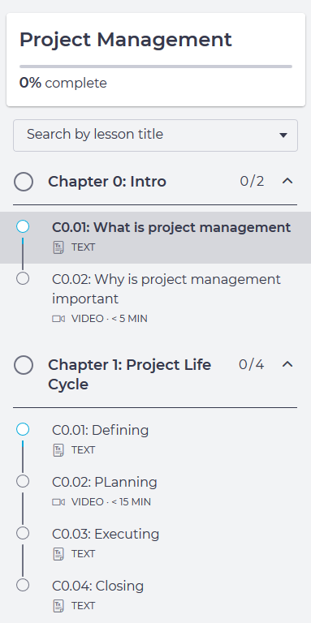
Project management - Why?
Project management is a critical job requirement for freelancers - It’s used to achieve goals in a time and cost sufficient matter.
Adopting project management structure would as well result in a more holistic level of interaction between freelancers and their clients and increasing their autonomy in the project. Making them a “business owner” managing their own project and not only creating a product or providing a service

Slide 11
Project Life Cycle
The project life cycle shows the nature of a project, it acknowledges that projects have limited lifespans with four stages it goes through.
As a freelancer you can have a range of projects for different clients in different stages of the cycle. Therefore, keeping track and planning the different components can be very beneficial.
Defining
Planning
Executing
Closing
02

Slide 12
Planning as a freelancer
Having a poor project scope is one of the most common barriers for a successful project. A project scope includes various components such as: Objectives, that are used to convert strategies into operational and measurable targets Deliverables, they clarify the objectives of the project and can be used as a communication tool for the stakeholders to have insight on the process
S.M.A.R.T = Specific, Measurable, Assignable, Realistic and Time related This guide can be used when setting objectives - Simplifying the necessary characteristics of objectives to drive a project to completion
Work breakdown structure (WBS) The different types of deliverables in a project can be shown by using this process, breaking them down into smaller parts = work packages, that are operational for one person. The WBS can serve as a framework for a freelancer to evaluate cost and time performance for each part of the project
02
04

Slide 13

Stakeholders
Who are they and how do you manage them?
Freelancers will recognize that there will be multiple stakeholders that they need to cooperate with when dealing with a project such as → top management, sponsors, government, contractors etc.
But the most important one being the client.
The freelancer has to identify the effect the stakeholders have on the project and build a cooperative network where the priority is to engage the project stakeholders and allow for change rather than directing and planning to achieve the goal
02

Slide 14
Controlling your resources
Bottoms up
Multi project resource schedule
For a freelancer using the approach “bottom-up” for estimating the time and cost of completing the different project deliverables would be most appropriate. Since this approach is generally used by the people executing the work where their estimates are found in the WBS. Associating the work packages with the matched cost accounts, available resources and detailed time estimates making them into major deliverables. These can be used as budgets and resource schedules for control, furthermore provide an insight for clients that want to compare the low-cost efficient method with specific restrictions.
Freelancers are often in a multi project environment where the projects are non-sequential to each other and the resources are scattered over the projects. Freelancers must develop a dynamic system to allocate, prioritize and schedule where their resources need to be applied across multiple projects with different requirements, time constraints and risks. By using a “multi project resource schedule” you approaching the individual projects as fragments of one major project can further enhance the resource flexibility over the individual projects and clarify the scheduling heuristics and priorities.

Slide 15
Risk Management
Risk Breakdown Structure During the whole project life cycle there will be risk factors that no amount of planning can overcome The approach of risk management is proactive rather than reactive and its an iterative process that is continuing throughout the whole project. Identifying the risks in the beginning of the project will minimize the cost. . By utilizing the approach called risk breakdown structure in concurrence with the WBS it can assist to identify potential risks. The breakdown structure starts focusing on risks affecting the whole project, further breaking down towards specific sections and objectives of the project.
What does it give? Having a successful risk management plan gives a freelancer better control of their future and improves the probability of reaching project objectives within the budget and schedule, furthermore enabling for creating a better reputation and a bigger network.

Slide 16
Budgeting
01
Why budget?
02
Preparing a budget
Establishing knowledge on what is a budget and why budgeting is important.
Step by step breakdown of creating a profit & loss budget and individual budgets that it contains.
03
Budgeting, Forecasting and Control
04
Break-even point analysis
Calculating values within specific budgets and exercising budgetary control
Introducing the break-even point analysis and how it helps to make decisions

Slide 17
Why Budget?
Budgets are based on the policies needed to fulfil the objectives of the entity.
Budgets are usually expressed in monetary terms.
Budgets are usually written down.
Budgets relate to a future period of time.
Budgets give you control as they serve as a basis for making decisions.
Budgets allow you to monitor actual performance of your work compared to budgeted results and enable you to correct any discrepancies.

Slide 18
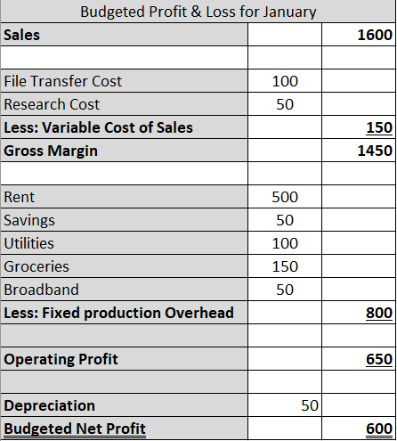
Preparing a budget
Sales budget
(Hours worked * rate)
Costs that change as you take on projects
Setting money aside for pension or savings would also classify as a fixed cost
Costs that don’t change with hours worked
Depreciation is a charge on assets that provide a general service to the business. Eg. a freelancer’s laptop

Slide 19
Budgeting, Forecasting and Control
When budgets have been put in place and actual results from your work are available you can examine the differences, also called variances, to see what changes occurred and what corrections need to be made.
Taking this action is called Budgetary Control.
This is done in order to make your future budgets more accurate and conform to what you set out initially.
3 Steps to Budgeting/Forecasting
The budget procedure starts with an examination of the entity’s objectives. Normally, it would start with a forecast. (Forecast is a prediction of what is likely to happen. Budget is a plan of what should happen.)
A period for a budget is set. It can be short or long depending on the project. 1 year is used as standard.
Decide on what sub-budgets will compose the main budget and populate them. Eg. Sales budget, Production budget, Administration budget, Cash budget.

Slide 20
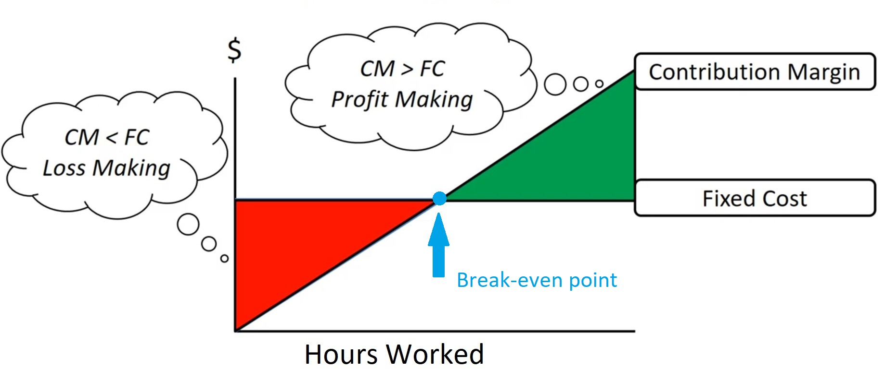

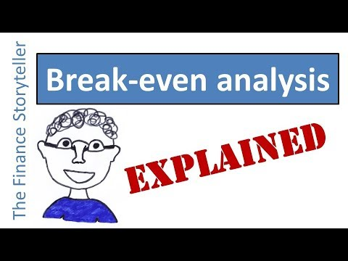
Break-even point analysis
Break-even point formula
The break-even point analysis allows you to increase your work’s profitability.
The formula can help you decide whether you need to increase the hours worked, decrease your fixed costs or variable costs or increase your rate to earn more money from your projects.

Slide 21
How to negotiate as a freelancer
1. Establish a relationship
It is important for a freelancer to establish personal relationships with their clients to negotiate fair contracts and recurring work opportunities.
2. Bargaining for a fair price
A freelancer is their own business owner and bargaining a fair price is now their own responsibility, implementing the right tools are essential for success in the industry.
3. Managing your clients
After establishing themselves in the industry the freelancer will be spending a lot of time negotiating contracts, therefore, it is necessary to identify which clients are worth the time invested in negotiating.
4. Principled negotiation
Principled negotiation is a useful way to negotiate as a freelancer, especially in cases where a powergap exists, between the freelancer and the client.

Slide 22
Negotiation
Establish a relationship
As a freelancer Your clients are your own responsibility, therefore, it is important that you establish a good relationship before negotiating technicalities of a contract. A lot of freelancers fail to establish a personal relationship and has already lost the negotiation before it has begun, resulting in poor arrangements, and sometimes forcing the freelancer to discount just to acquire essential work. To counteract this you should start by, letting your employer know who you are, what drives you, what you have accomplished and how you can bring their projects to life is essential in cooperating on fair contracts. Furthermore, a good relationship ensures a fair wage with good benefits, as well as returning work and future opportunities!
When establishing a relationship with a client there are three important points to communicate:
1) Emphasize your values and beliefs:
Letting your employer know what your beliefs are as one of the first things sets the tone for the relationship. Showing what motivates you and gets you out of bed in the morning is a great way to start a conversation or a negotiation with a client, it lets them know that what you are doing is done with passion and not only to make ends meet.
2) Explain what you have done to realise these beliefs:
Displaying where you came from and what you have done to realise these beliefs is just as important, empty words hold no meaning, show the client your portfolio and tell the stories behind what got you to where you are now.

Slide 23
Negotiation
Bargain for a fair price
Once a personal relationship has been established you can start bargaining for the terms of the contract. A common pitfall for freelancers and contractors in general is they overuse price discounting; this should only be used as a last resort and only rarely!
Before initiating the contract writing, be sure to be prepared for the negotiation by following these three steps:
First: Look at the market standards for projects like the one you will be working on.
It is essential to research the market first and foremost, this will let you know if you are getting the proper wage and security for a project, it takes little time and gives you a lot of information to use in the negotiation.
Second: Establish a minimum and maximum price.
Doing this will give you some room to move around when the client asks you what the price of the project will be, furthermore, it lets you know when to stop negotiating with the person if they will not comply with the minimum price.
Third: Identify who you are negotiating with.
Some clients will try to press you down in price regardless of market standards or if you start at the minimum price initially. Try to profile the client and see if you can manage to hit a fair price by sometimes starting a little too high.

Slide 24
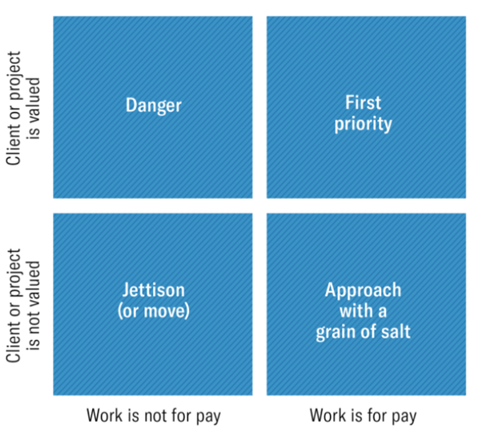
Negotiation
Manage your clients
After the first few contracts have landed and you are already working on projects it might be necessary to start saying no to some of the contracts you are being offered, because negotiating can be time consuming and take a lot of effort; but who should you say no to?
It is up to you who you want to work with but to help you along the way is the following figure:
This figure lets you recognize which clients you should prioritize, and which clients should potentially cut-off. It is of course always important to focus on clients where work is for pay and the client is valued, as this has the highest priority to yield returning work, and clients who are not certainly for pay and the client is not valued should always be the last on the list of negotiations. Take this with a grain of salt its up to you to make the decisions this model is just a guiding tool.

Slide 25
Negotiation
Principled negotiation
When there is a big power distance between you and your client it might be disheartening, and the client might drive a hard bargain; but do not get discouraged!
Now that you have completed your research in the second step you can implement something called principled negotiation. This method of negotiation is a tool that always refer to the objective standards in the industry, because as you might now it is hard to argue with facts. When implementing principled negotiation, it is important to first.
1) Remove the personal interests from the negotiation.
This allows you and your client to leave personal issues and such outside of the negotiation terms.
1) Focus on interests and goals of the negotiation.
Now that you do not have personal interest to comply to, you can work together on the shared goal of the negotiation.
2) Allow new possibilities and solutions to come forward.
Get creative with your client and brainstorm together how both parties might benefit even more from this negotiation.
3) Refer to objective standards.
If they drive a hard bargain always refer to market rates and objective standards, the client will either must comply with facts or the contract probably was not worth the effort regardless.
On the next slide is an example of principled negotiation:

Slide 26
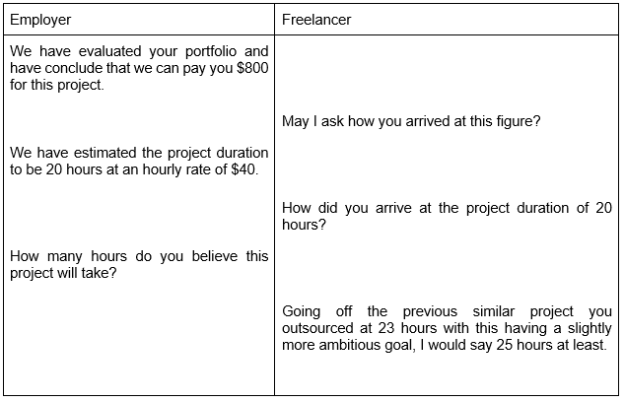
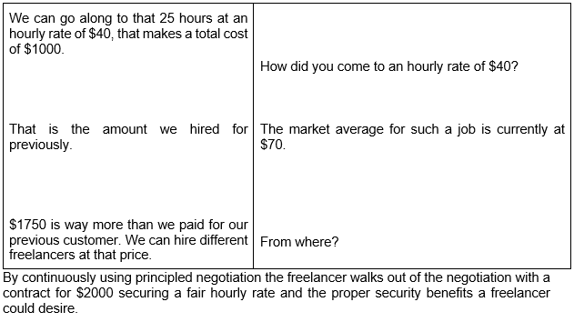
Negotiation
Example of principled negotiation:

Slide 27
Future expectations
Business skills course
Quiz
Through collecting information about the user using the questionnaire, reducing the questions to a minimum and suggesting a course they would likely benefit from, we would be able to minimize the friction of choice, improving the new student conversion rate.
We anticipate that students who take our course will gain important knowledge about controlling costs and time in a sufficient manner, as well as cooperate and negotiate with different stakeholders to succeed as a freelancer.

Slide 28
Thank you for your time!
For further questions:
airi0046@stud.kea.dk
edva0264@stud.kea.dk
cori0268@stud.kea.dk
tobi794i@stud.kea.dk
pety0045@stud.kea.dk
CREDITS: This presentation was created by Slidesgo, including icons by Flaticon and infographics & images by Freepik

